Slide 1
Database Design Chat 013
Second and Third Normal Form

Slide 2

Louis Davidson (drsql)
https://linktr.ee/drsql

Slide 3
Review
Column values
are atomic/scalars
In previous chats, we have defined the table:
X | Y | Z
1 | 1 | 2
2 | 2 | 4
3 | 2 | 4
Rows are unique
Values ONLY accessed by
Table Name, Key Value,
and Column Name

Slide 4
Normal Forms Overview – 2NF, 3NF
Limited duplication of data by reducing extraneous dependencies
All data is either independent or is dependent on one other piece of data
All attributes are either a key, or fully dependent on a key (the whole key, and nothing but the key)
Violations usually manifest themselves as multiple column, row-wise repeating groups
In other words…
All keys for a table are identified
All non-key columns describe that “thing” the table models
Notes:
Think of it this way. A key represents the entity that is being model. An attribute describes the entity being modeled. AND NOTHING ELSE…
Sounds simple…AND IT IS…. Just requires thinking…

Slide 5
Intrarow Dependency
If you can determine the value of one attribute X given a different attribute Y, then Y is functionally dependent on X. X is considered the determinant. Example:
Assuming this is the entire universe. X is unique key:
Y and Z are functionally dependent on X
Z is possibly functionally dependent on Y (or vice versa)
X | Y | Z
1 | 1 | 2
2 | 2 | 4
3 | 2 | 4
Am I a table, or a coincidence?

Slide 6


Second Normal Form
All attributes must be a fact about the entire primary key and not a subset of the primary key

Slide 7
Second Normal Form Example
Requirement: Defines the types of car(s) that a driver likes.
DriverCarStylePreference
------------------------
Driver Car Style Height EyeColor MaxWeight
======== ================ ------- --------- ----------
Louis Station Wagon 6’0” Blue 2900
Louis Hatchback 6’0” Blue 2500
Ted Coupe 5’8” Brown 2200

Slide 8
Second Normal Form Example
Test each attribute against the entire key (Any values aren’t dependent on both attributes are wrong.)
Height and EyeColor are almost certainly attributes of the driver alone
MaxWeight? The weight of vehicle and driver? For that style of car? Or the driver?
Requirements and Naming are important!
To not be tricky, MaxWeight is the weight of the vehicle that the driver will accept
Driver Car Style Height EyeColor MaxWeight
======== ================ ------- --------- ----------
Louis Station Wagon 6’0” Blue 2900
Louis Hatchback 6’0” Blue 2500
Ted Coupe 5’8” Brown 2200

Slide 9
Second Normal Form Example
Solution: 3 independent tables, 1 for driver, 1 for driver’s car style preference, 1 for driver and car style
Driver
------
Driver Height EyeColor
======== ------- ---------
Louis 6’0” Blue
Ted 5’8” Brown
DriverCarStylePreference
------------------------
Driver Car Style
======== ================
Louis Station Wagon
Louis Hatchback
Ted Coupe
CarStyle
--------
CarStyle MaxWeight
================ ----------
Station Wagon 2900
Hatchback 2500
Coupe 2200

Slide 10
Third Normal Form
All attributes must be a fact about the primary key and nothing but the primary key

Slide 11
Third Normal Form Example
Requirement: Driver registration for rental car company
Driver
------
Driver VehicleOwned Height EyeColor WheelCount
======== ---------------- ------- --------- ----------
Louis Hatchback 6’0” Blue 4
Ted Coupe 5’8” Brown 4
Rob Tractor trailer 6’8” NULL 18

Slide 12
Third Normal Form Example
Driver VehicleOwned Height EyeColor WheelCount
======== ---------------- ------- --------- ----------
Louis Hatchback 6’0” Blue 4
Ted Coupe 5’8” Brown 4
Rob Tractor trailer 6’8” NULL 18
Height and EyeColor, check
VehicleOwned, check
WheelCount, <buzz>, driver’s do not have wheel counts

Slide 13
Third Normal Form Example
Two tables, one for driver, one for type of vehicles and one for the characteristics of a vehicle
Driver
------
Driver OwnedVehicleType(FK) Height EyeColor
======== -------------------- ------- ---------
Louis Hatchback 6’0” Blue
Ted Coupe 5’8” Brown
Rob Tractor trailer 6’8” NULL
VehicleType
-----------
VehicleType WheelCount
================ -----------
Hatchback 4
Coupe 4
Tractor trailer 18

Slide 14
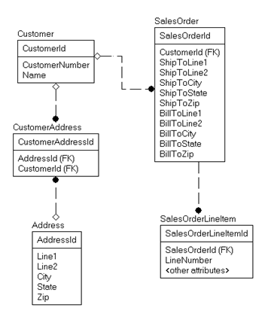
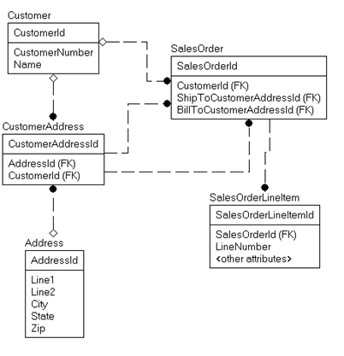
Which Model is Correct?
Key values represent
values in the other table
Column values
duplicated

Slide 15
What does it mean in context?
The value of the customers address at query time
The value of the customers address at order/shipment time.

Slide 16
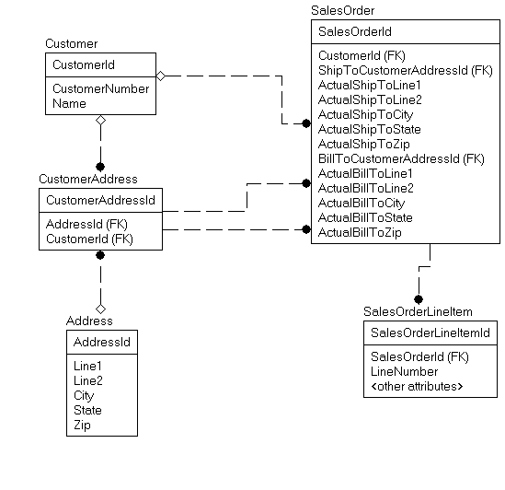
Answer - It depends…but probably both make sense…
This is why names matter so much…

Slide 17
Concerning things to look for with 2NF and 3NF...
There are multiple columns with the same prefix
Example: Address.CityName,.CityStateName, .CityPopulation, .CityMotto
Multiple tables have the exact same complex columns
Example: Three tables have .MessageSentDate, .MessageText columns
There are repeating groups of data
There are triggers with modification statements
Some trigger use to initiate workflow can make sense, but too often it is a matter or maintaining summary/status data

Slide 18
Be Careful What You Call a Dependency Issue
For example, consider a person’s name, still keeping it simple (proper natural key omitted).
Is NickName duplicated data?
Or is it data that looks the same at this single point in time?
Some data is simply the same by default, but allows for user to set an overridden value
PersonId FirstName LastName NickName
======== ---------------- ---------------- ----------
Louis Davidson Louis
Kevin Kline Kevin
Grant Fritchey Grant
Tim Ford Tim

Slide 19
Be Careful What You Call a Normalization Issue
Sometimes, duplication is there to allow overrides:
PersonId FirstName LastName NickName
======== ---------------- ---------------- ----------
Louis Davidson Dr SQL
Kevin Kline Kevin
Grant Fritchey Scary DBA
Tim Ford SQL Agent Man

Slide 20
Until next time…
Hopefully you see now that the goal is to eliminate (or at least identify) duplication.
Real issues are not going to advertise themselves like I have all the time.
Goal: 1 data change = 1 update or…

Slide 21
Fixing data like this becomes your life
Driver Car Style Height EyeColor MaxWeight
======== ================ ------- --------- ----------
Louis Station Wagon 6’0” Blue 2900
Louis Hatchback 6’0” Blue 2500
Ted Coupe 5’8” Brown 2200
Lisa Station Wagon 5’2” Green 2900
Joe Station Wagon 6’1” Blue 2900
Bob Station Wagon 4’2” Brown 2900
Geoffrey Station Wagon 5’11” Brown 2900
Betty Station Wagon 5’1” Red 2900

Slide 22
Questions?
If you have questions, you can:
Comment on YouTube
Email drsql@hotmail.com
Message me on Twitter at drsql
Contact me anywhere on https://linktr.ee/drsql
I may add an episode to discuss or reply directly

